Slide 1

職場故事
(Animaze)

Slide 2
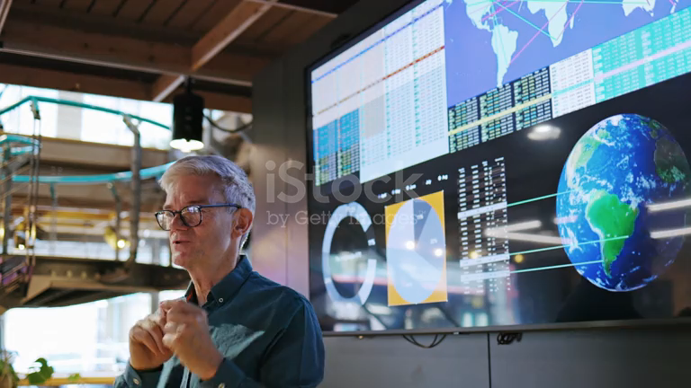
1.目標
Notes:
academic research

Slide 3

2.阻礙
Notes:
Difficulties in team collaboration

Slide 4

3.努力
Notes:
challenges, I continue to learn and adjust my work process

Slide 5

4.結果
Notes:
My technology solutions successfully solved business problems

Slide 6
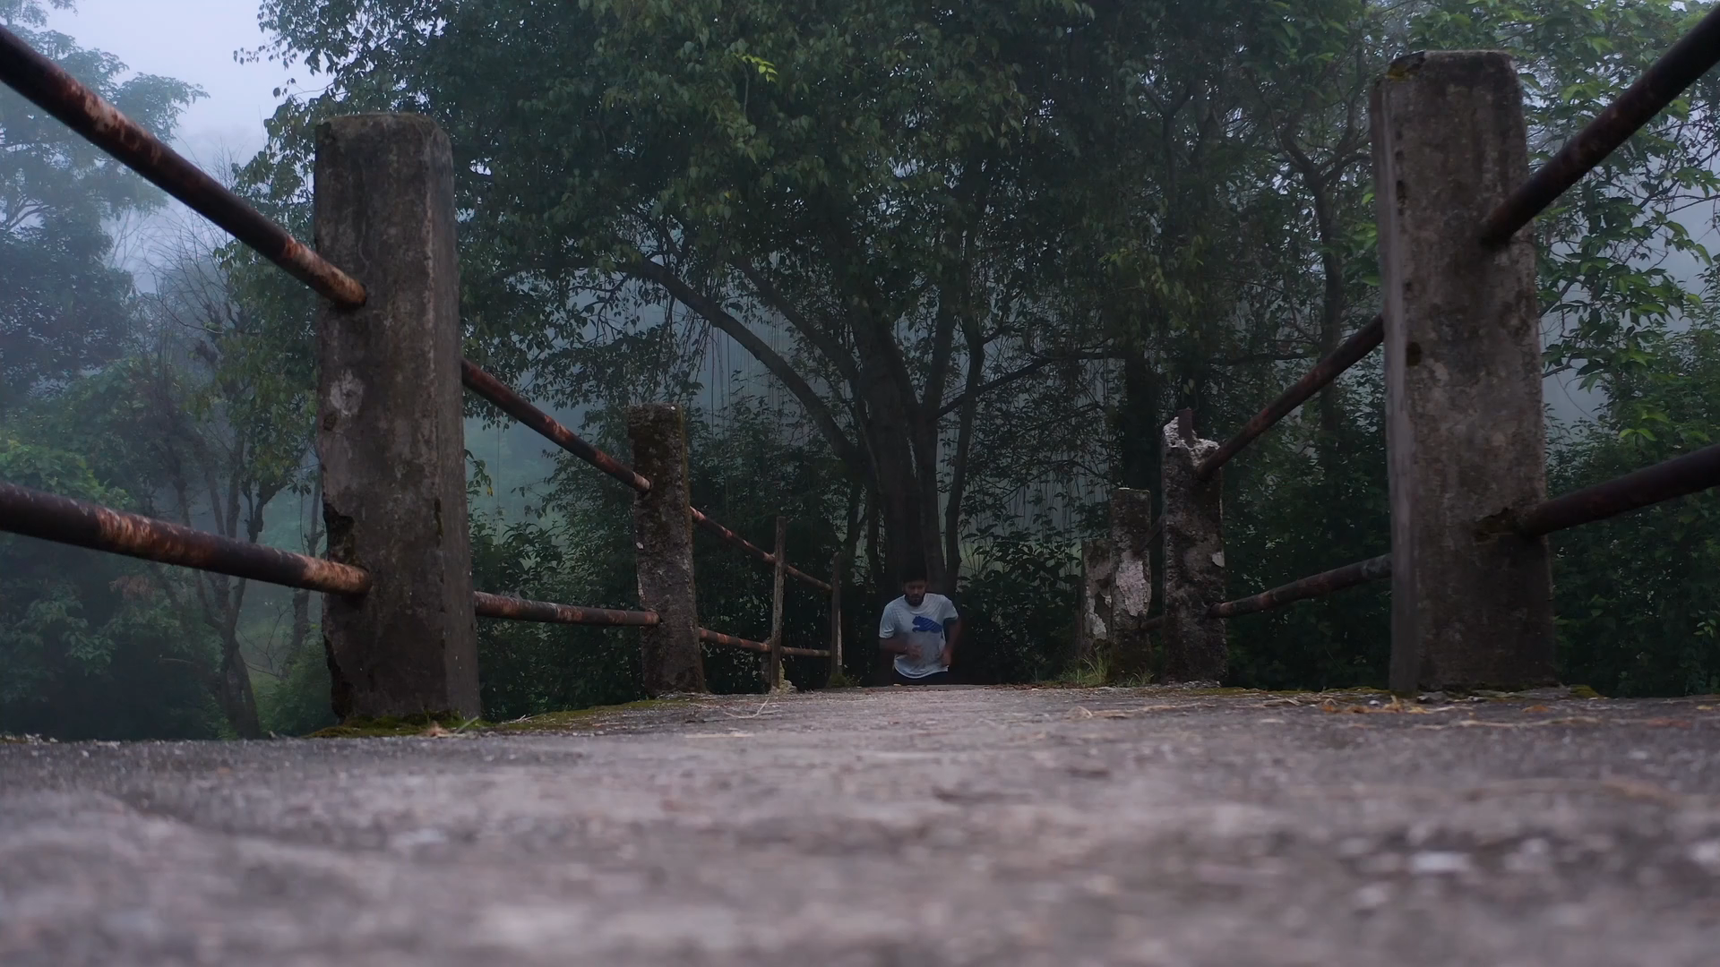
5.意外
Notes:
Mastered how to survive in the workplace

Slide 7

6.轉彎
Notes:
Learn market analysis and user experience design

Slide 8

7.結局
Notes:
became a technical expert

